Slide 1
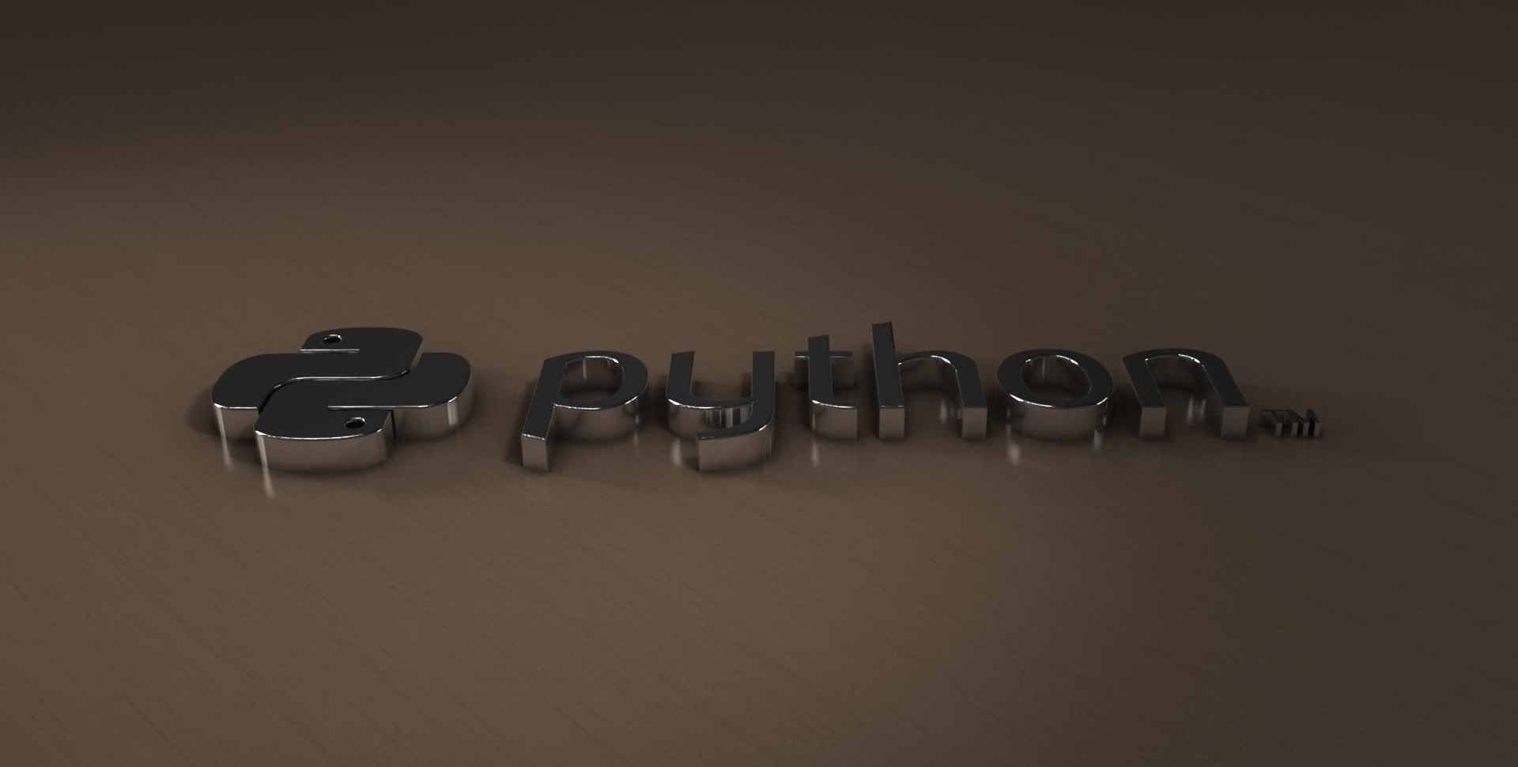
PYTHON TUTURIAL
BY- ARIF KHAN
INORMATION TECHNOLOGY

Slide 2
CONTENT
Introduction
History
Installation
Numbers
Casting
String
Operators
List
Tuple
Sets
Dictionary
Control
Loop
Functions
Oop’s

Slide 3
INTRODUCTION
Python is a general-purpose interpreted, interactive, object-oriented, and high-level programming language. It was created by Guido van Rossum during 27 feb.1991 LikePerl, Python source code is also available under the GNU General Public License (GPL).
Python is a high-level, interpreted, interactive and object-oriented scripting language. Python is designed to be highly readable. It uses English keywords frequently where as other languages use punctuation, and it has fewer syntactical constructions than other languages(case sensitive).

Slide 4
HISTORY
History: who, when , where and why
Ancestors of python
Python: the name
Version history

Slide 5
BEGGINNING
The idea of python started in early 1980s
Real implementation started in 1989
Finally published in 1991[27 feb 1991]

Slide 6
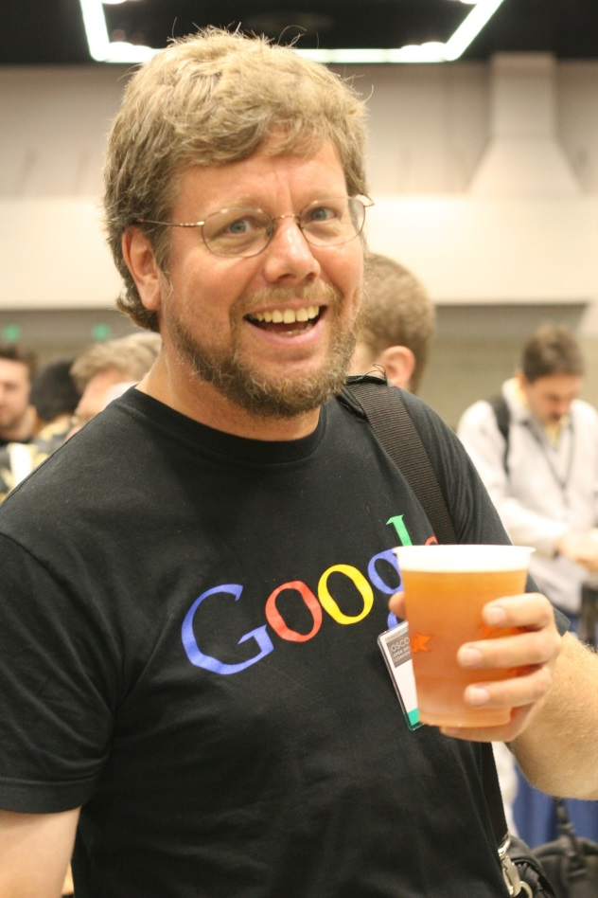
WHO
Python is an experiment in how much freedom programmers need.
Too much freedom and nobody can read another code; too little and expressiveness is endangered
Neitherland org.(gietherland)
Guido van Rossom(31 jan 1956)

Slide 7
where
The centrum Wiskunde & Informatica is a research center in the field of mathematics and theoretical computer science

Slide 8
Ancestors
ABC language influenced by setl was developed at CWI, intended to replace BASIC , pascal
ABC had a influence on the design of python programming language
It also worked on Modulla concept
Handled the Ameeba distributed system(os)
Seris- the best of monty python

Slide 9
Why was python created
“My original python motivation for creating python was the perceived need for a higher level language in the Amoeba{operating system} project.
I realized that the development
Of system administration utilities in c was taking too long.Moreover,doing these things in the Bourne shell woouldn’t work for a variety of reasons….
so,there was a need for a language that would bridge the gap between C and the shell”

Slide 10
SCOPE OF PYTHON
Science
-Bioinformatics
System Administration
-Unix
-Web logic
-web sphere
Web application Development
-CGI(common gateway interface)
-jypthon—Servlets
Testing scripting
AI
ML
IOT

Slide 11
WHAT CAN I DO WITH PYTHON….?
System programming
Graphical User Interface Programming
Internet Scripting
Component Integration
Database Programming
Gaming ,Images, XML, ROBOT AND more

Slide 12
WHO USES PYTHON TODAY
Python is being applied in real revenue-generating products by real companies FOR instance.
Google makes extensive use of pythons in its web search system , and employs Python’s creator.
Intel , cisco, Hewlett-Packard , Segate , Qualcomm, and IBM use python for hardware testing.
ESRI uses Python as an end-user customization tool for its popular GIS mapping products.
The you tube video sharing service is largely written in python.

Slide 13
WHY DO PEOPLE USE PYTHON…?
The following primary factors cited by python users seem to be these:
Python is object –oriented.
Structure supports such concepts as polymorphism,
Operation overloading , and multiple inheritance
It’s free(open source)
Downloading and installing Python is free and easy source code is easily accessible.
sdddddd

Slide 14
It’s powerful
-Dynamic typing
-Built-in types and tools
-Library utilities
-Third party utilities(e.g.Numeric,Numpy,Scipy)
-Automation memory management.
It’s portable
-python runs virtually every major platform used today
-As long as you have a compatible Python interpreter installed, python Progrms will run in exactly the same manner, irrespictive of platform.

Slide 15
Installing Python
Python is pre-installed on most Unix system ,including Linux and MACS X
But for in windows Operating system ,user can download from the
https://www.python.org/downloads/
-from the above link download latest version of python IDE and install , recent version is 3.7.1

Slide 16
NUMBERS
x = 1 y = 35656222554887711 z = -3255522 print(type(x)) print(type(y)) print(type(z))

Slide 17
CASTING
x = int(1) # x will be 1 y = int(2.8) # y will be 2 z = int("3") # z will be 3

Slide 18
STRING
a = "Hello, World!" print(a[1])
-→E
1) a = "Hello, World!" print(a.upper())
2) a = "Hello, World!" print(a.replace("H", "J"))

Slide 19
3) age = 36 txt = "My name is John, and I am {}" print(txt.format(age))
4)CASEFOLD 7)ISALPHA
5)FIND 8)ISALNUM
6)INDEX

Slide 20
Python Operators
Python divides the operators in the following groups:
Arithmetic operators (+,-,*,/,%, //, **)
Assignment operators(=, +=, -=, *=……)
Comparison operators(==,!=, <=, >=, < , >)
Logical operators( and , or ,not)
Identity operators(is, is not)[x = ["apple", "banana"]
y = ["apple", "banana"]
z = x]
Membership operators(in ,not in)
Bitwise operators(& , OR, ~, )

Slide 21
LIST
List is a collection which is ordered and changeable.[]
1)Mutable
2)Changeable
3)Duplicate members
4)Store anything
5)Works as constructor

Slide 22
EXAMPLE
thislist = ["apple", "banana", "cherry"] print(thislist)
thislist = ["apple", "banana", "cherry"] thislist[1] = "blackcurrant" print(thislist)
thislist = ["apple", "banana", "cherry"] thislist.append("orange") print(thislist)

Slide 23
List methods
append() | Adds an element at the end of the list
clear() | Removes all the elements from the list
copy() | Returns a copy of the list
count() | Returns the number of elements with the specified value
extend() | Add the elements of a list (or any iterable), to the end of the current list
index() | Returns the index of the first element with the specified value
insert() | Adds an element at the specified position
pop() | Removes the element at the specified position
remove() | Removes the item with the specified value
reverse() | Reverses the order of the list
sort() | Sorts the list

Slide 24
TUPLE
Tuple() is a collection which is ordered and unchangeable. Allows duplicatemembers.
Contain heterogeneous data
Faster than list
Store anything
Not change

Slide 25
EXAMPLE
thistuple = ("apple", "banana", "cherry") print(thistuple)

Slide 26
TUPLE METHODS
count() | Returns the number of times a specified value occurs in a tuple
index() | Searches the tuple for a specified value and returns the position of where it was found

Slide 27
SETS
Set is a collection which is unordered and unindexed. No duplicate members.
EXAMPLE—
thisset = {"apple", "banana", "cherry"} thisset.add("orange") print(thisset)

Slide 28
SETS METHOD
Method | Description
add() | Adds an element to the set
clear() | Removes all the elements from the set
copy() | Returns a copy of the set
difference() | Returns a set containing the difference between two or more sets
discard() | Remove the specified item
intersection() | Returns a set, that is the intersection of two other sets
isdisjoint() | Returns whether two sets have a intersection or not

Slide 29
SETS METHOD
pop() | Removes an element from the set
remove() | Removes the specified element
union() | Return a set containing the union of sets
update() | Update the set with the union of this set and others

Slide 30
DICTIONARY
Dictionary{} is a collection which is unordered, changeable and indexed. No duplicate members
Mutable
Dict(key , values)

Slide 31
EXAMPLE
thisdict = { "brand": "Ford", "model": "Mustang", "year": 1964 } print(thisdict)

Slide 32
DICTIONARY METHODS
Method | Description
clear() | Removes all the elements from the dictionary
copy() | Returns a copy of the dictionary
fromkeys() | Returns a dictionary with the specified keys and values
get() | Returns the value of the specified key
items() | Returns a list containing the a tuple for each key value pair
keys() | Returns a list containing the dictionary's keys
pop() | Removes the element with the specified key
popitem() | Removes the last inserted key-value pair
setdefault() | Returns the value of the specified key. If the key does not exist: insert the key, with the specified value
update() | Updates the dictionary with the specified key-value pairs
values() | Returns a list of all the values in the dictionary

Slide 33
CONTROL
a = 200
b = 33
if b > a:
print("b is greater than a")
elif a == b:
print("a and b are equal")
else:
print("a is greater than b")

Slide 34
WHILE LOOP
i = 1 while i < 6: print(i) if i == 3: break i += 1

Slide 35
CONTINUE
i = 0 while i < 6: i += 1 if i == 3: continue print(i)

Slide 36
FOR LOOP
The for loop does not require an indexing variable to set beforehand.
fruits = ["apple", "banana", "cherry"]
for x in fruits:
print(x)
if x == "banana":
break

Slide 37
FUNCTIONS
A function is a block of code which only runs when it is called.
You can pass data, known as parameters, into a function.
A function can return data as a result.
EXAMPLE-
def my_function():
print("Hello from a function")
my_function()

Slide 38
LAMBDA
A lambda function is a small anonymous function.(define without name)
A lambda function can take any number of arguments, but can only have one expression
=>lambda arguments : expression.
EXAMPLE—
x = lambda a: a + 10
print(x(5))

Slide 39
These are 3 types
MAP(function , seq)
map() can be applied to more than one list. The lists have to have the same length.
REDUCE
The function reduce(function , seq) continually applies the function func () to the sequence seq. It returns a single value.
FILTER
The function filter(function, list) offers an elegant way to filter out all the elements of a list, for which the function function returns True.

Slide 40
What is Object Oriented Programming?
Object Oriented programming is a programming style that is associated with the concept of Class, Objects and various other concepts revolving around these two, like Inheritance, Polymorphism, Abstraction, Encapsulation etc.

Slide 41
CLASS/OBJECTS
Python has been an object-oriented language since it existed. Because of this, creating and using classes and objects .

Slide 42
OOP Terminology
Class
Data member
Inheritance
Instance
Method
Object
polymorphism

Slide 43
CLASS
A user-defined prototype for an object that defines a set of attributes that characterize any object of the class. The attributes are data members (class variables and instance variables) and methods, accessed via dot notation.

Slide 44
DATA MEMBER
A class variable or instance variable that holds data associated with a class and its objects.

Slide 45
INHERITANCE
The transfer of the characteristics of a class to other classes that are derived from it.

Slide 46
INSTANCE
An object is created using the constructor of the class .This object will then be called the instance.

Slide 47
METHOD
A special kind of function that is defined in a class definition.

Slide 48
OBJECT
A unique instance of a data structure that's defined by its class. An object comprises both data members (class variables and instance variables) and methods

Slide 49
OBJECT TYPES
Identity: Identity refers to some piece of information that can be used to identify the object of a class. It can be the name of the student, the company name of the car, etc.
Properties: The attributes of that object are called properties. Like age, gender, DOB for a student; or type of engine, number of gears for a car.
Behaviour: Behaviour of any object is equivalent to the functions that it can perform. In OOP it is possible to assign some functions to objects of a class. Taking the example forward, like a student can read/write, the car can accelerate and so on.

Slide 50
POLYMORPHISM
Polymorphism means same function name(but diff.signatures) being uses for diff.types

Slide 51
CONSTRUCTER
Constructors are generally used for instantiating an object.The task of constructors is to initialize(assign values) to the data members of the class when an object of class is created.
In Python the __init__() method is called the constructor and is always called when an object is created.

Slide 52
TYPES OF CONSTRUCTER
default constructor :The default constructor is simple constructor which doesn’t accept any arguments.It’s definition has only one argument which is a reference to the instance being constructed.
parameterized constructor :constructor with parameters is known as parameterized constructor.The parameterized constructor take its first argument as a reference to the instance being constructed known as self and the rest of the arguments are provided by the programmer.

Slide 53
Destructors
a constructor is used to create and initialize an object, a destructor is used to destroy the object and perform the final clean up.
in python we do have garbage collector to clean up the memory, but its not just memory which has to be freed when an object is dereferenced or destroyed, it can be a lot of other resources as well, like closing open files, closing database connections, cleaning up the buffer or cache etc. Hence when we say the final clean up, it doesn't only mean cleaning up the memory resources.

Slide 54
EXAMPLE
class Vehicle: def __init__(self): print('Vehicle created.') def __del__(self): print('Destructor called, vehicle deleted.') car = Vehicle() del car
O/P->Vehicle created. Destructor called, vehicle deleted.

Slide 55
INHERITANCE
The class which inherits another class is generally known as the Child class, while the class which is inherited by other classes is called as the Parent class.

Slide 56
EXAMPLE
class Animal:
def speak(self):
print("Animal Speaking")
#child class Dog inherits the base class Animal
class Dog(Animal):
def bark(self):
print("dog barking")
d = Dog()
d.bark()
d.speak()
Output:
dog barking
Animal Speaking

Slide 57
Access modifiers
In object-oriented languages access modifiers are used to limit the access to the variables and functions of a class. Most of the languages use three types of access modifiers, they are - private(__), public and protected.(_)

Slide 58
TYPES OF INHERITANCE
Single level inheritance
Multiple inheritance
Multilevel Inheritance

Slide 59
EXAMPLE OF MULTIPLE INHERITANCE
class CompanyOne:
def GetProductionOne(self):
self._totalMobile_One=int(input("Total Production Company One?"))
def PutProductionOne(self):
print('Total Production Company One:',self._totalMobile_One)
class CompanyTwo:
def GetProductionTwo(self):
self._totalMobile_Two=int(input("Total Production Company Two?"))
def PutProductionTwo(self):
print('Total Production Company One:',self._totalMobile_Two)
class TotalProduction(CompanyOne,CompanyTwo):
def TotalProduction(self):
self.GetProductionOne()
self.GetProductionTwo()
self.__total=self._totalMobile_One+self._totalMobile_Two
def ShowTotalProduction(self):
self.PutProductionOne() self.PutProductionTwo()
print("Total Production:",self.__total)
C=TotalProduction()
C.TotalProduction()
C.ShowTotalProduction()

Slide 60
O/P→
Total Production Company One?44
Total Production Company Two?5
Total Production Company One: 44
Total Production Company One: 5
Total Production: 49
>>>

Slide 61
Thank you
For listening

